Slide 1
Earth’s Interior

Slide 2
Exploring Inside Earth
How do geologists answer the question: what’s inside earth?
Evidence:
Direct evidence:
Rock samples
Have only drilled holes 12 km into Earth
Forces blast rocks to surface
Indirect evidence:
Seismic waves
Speeds and path of waves reveal structure

Slide 3
How do the layers of Earth vary?
Size
Composition
Temperature
At first it cools, but as you get about 20 meters down it gets warmer.
Every 40 meters you go down it increases temp. by 1 C degree
Result of heat left over from formation and radioactive substances inside Earth that release energy
Pressure
Force pressing on an area
Increases the deeper you go down

Slide 4
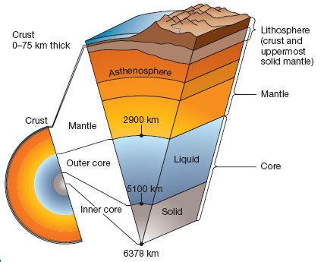
Layers of the Earth

Slide 5
Crust
Layer of solid rock that includes both dry land and ocean floor
Includes soil and water
Thickest at mountains
Thinnest beneath the ocean
Between 5-40 km thick
Continental crust
Consists mainly of rock such as granite
Light color with a coarse texture
Oceanic crust
Consists mostly of rock such as basalt
Dark rock with fine texture

Slide 6
Mantle
Layer of hot rock that is still solid
About 3000 km thick
Lithosphere
Rigid layer
About 100 km thick
Asthenosphere
Less rigid than rock above (softened road tar)
Can bend like plastic
Lower mantle

Slide 7
Core
Made of metals of iron and nickel
About 3,500 k thick
Liquid outer core
Layer of molten metal
Solid inner core
dense ball of solid metal
Extreme pressure squeezes the atoms of iron and nickel so they cannot spread out and become liquid
Core may also contain oxygen, sulfur and silicon
Magnetic field
Movements of liquid outer core create field

Slide 8
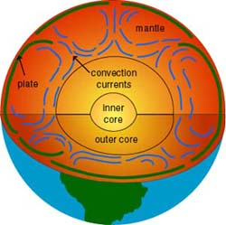
Convection Currents in Earth
Heat from core and mantle causes convection currents
There are also convection currents in the core.

Slide 9
Continental Drift
Alfred Wegener
Hypothesis: All continents were once joined together in a single landmass and have since drifted apart.
Idea became know as continental drift
Pangaea-existed about 300 million years ago

Slide 10
Evidence of Continental Drift
Land Features
Mountains ranges lined up on Africa and South America
European coal fields match those in North America
Fossils
Trace of an ancient organism that has been preserved in rock
Climate
As continents move close to and farther away from equator, temperatures change. It carries fossils with it.
South Africa was closer to south pole when Pangaea existed.

Slide 11
Wegener’s Hypothesis Rejected
He could not provide a cause for continental drive or the force that pushes or pulls the continents.
They would also have to change the idea about how mountains formed.
In 1900’s, they thought that they formed because the Earth was cooling and shrinking.
Wegener said that continents collide and fold up to form mountains.

Slide 12
Mid-Ocean Ridges
Mapped oceanic crust using solar
device that bounces sound waves off underwater objects and then records the echoes. The time it takes the echo to arrive indicates distance.
Underwater mountains
Where sea-floor spreading occurs

Slide 13
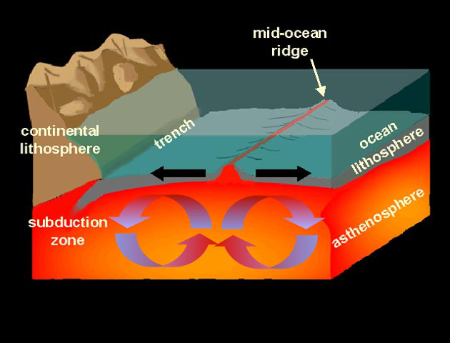
Sea-Floor Spreading
Harry Hess
Proposed process of sea-floor spreading which is the process that constantly adds new material to ocean floor

Slide 14
Evidence for Sea-Floor Spreading
Molten material
Alvin: underwater submarine
Rocks samples that looked like pillows
Molten lava that hardens quickly after erupting
Magnetic stripes
Magnetic poles have reversed itself many times during Earth’s history
Rock has magnetic memory
Drilling samples
Glomar Challenger: drilling ship
Farther from a ridge samples were taken the older the rocks

Slide 15
Subduction at Trenches
Deep-ocean trenches: where ocean floor plunges into deep under water canyons
Crust bends downward
Subduction: process where oceanic crust sinks back into mantle
Ocean floor is renewed every 200 million years
In Pacific Ocean, it is shrinking because subduction is occurring faster than sea-floor spreading.

Slide 16
Subduction

Slide 17
Theory of Plate Tectonics
Pieces of Earth’s lithosphere are in slow constant motion, driven by convection current
Explains the formation, movement, and subduction of plates
Convection currents drive plate motion
Faults: breaks in Earth’s crust where rocks have slipped past each other
Satellites measure plate movement
1 to 24 cm a year

Slide 18
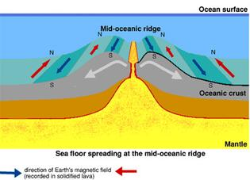
Plate Boundaries
Divergent boundaries
Two plates move apart or diverge
Occur along mid-ocean ridges where sea-floor spreading occurs
Occur on land as a rift valley

Slide 19
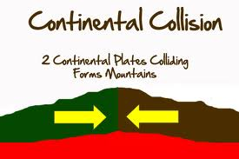
Plate Boundaries
Convergent boundaries
Two plates come together or converge
Result is a collision
Density of plates determines which comes out on top
2 oceanic plates collide and denser one sinks
Oceanic plate collides with continental plate and denser oceanic plate sinks (subduction)
2 continental plates collide and push up into mountains

Slide 20
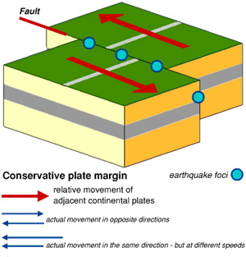
Plate Boundaries
Transform Boundaries
Place where two plates slip past each other moving in opposite directions
Earthquakes occur here
Crust is neither created or destroyed

