Slide 1
Living Things

Slide 2
Characteristics of Living Things (organisms)
Cellular organization
Cell basic unit of structure and function
Unicellular: single-celled organisms
Multicellular: organisms composed of many cells
Contains similar chemicals
Most abundant chemical is water.
Main energy source is carbohydrates.
Building materials of cells are proteins and lipids
Genetic material is nucleic acids
Use energy
Need to grow and repair

Slide 3
Characteristics of Living Things (organisms)
Respond to their surroundings
Stimulus
Response
Grow and develop
Growth is the process of becoming larger.
Development is the process of change that occurs during an organism’s life to produce a more complex organism.
Reproduce

Slide 4
Life Comes from Other Life
400 years ago, people believed that life could appear from nonliving material which is called spontaneous generation
Redi’s Experiment
Flies do not arise from decaying meat
Manipulated variable: whether or not the jar was covered
Conclude that rotting meat does not produce flies
Pasteur’s Experiment
New bacteria in broth appeared only when they were produced by existing bacteria

Slide 5
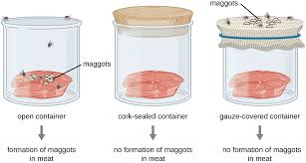
Redi’s Experiment

Slide 6
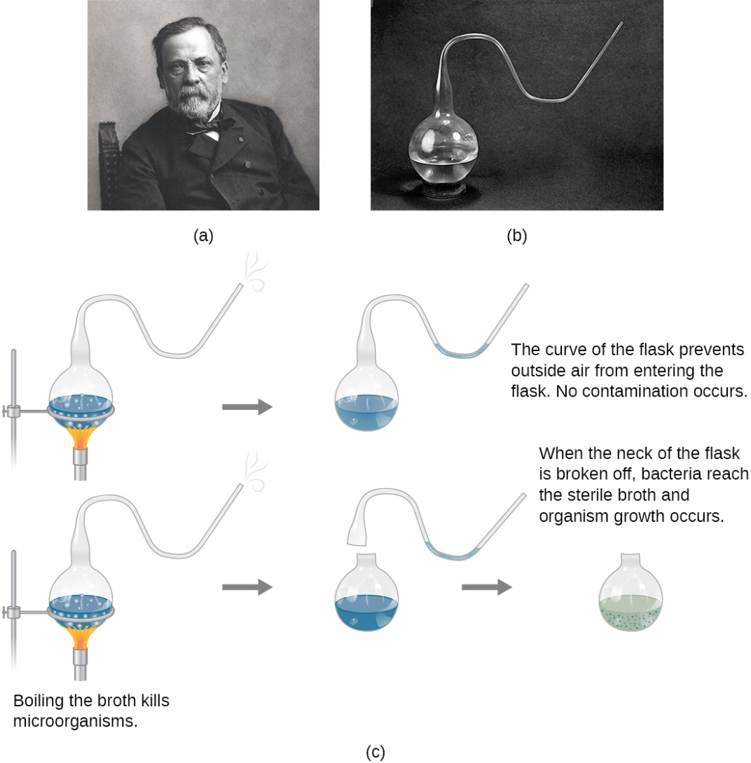
Pasteur’s Experiment

Slide 7
Needs of Living Things
Food
Autotrophs
Heterotrophs
Water is used:
To obtain chemicals from their surroundings
To break down food
To grow
To move substances in body
To reproduce
To carry away wastes
Living space (limited on earth)
Stable internal conditions (homeostasis)

Slide 8
Why do Scientists Classify?
Classification: process of grouping things based on their similarities
Why? Easier to study
Taxonomy: study of how things are classified

Slide 9
Naming System of Linnaeus
1750’s Carolus Linnaeus placed organisms in groups based on their observable features.
Binomial nomenclature
Genus: classification grouping that contains similar closely related organisms
Species: group of similar organisms that can mate with each other and produce offspring that can also mate and reproduce
Based on where it lives or its appearance
First word capitalized
Second word lowercase
Italics

Slide 10
Levels of Classification
The more classification levels that two organisms share the more characteristics they have in common.

Slide 11
Taxonomic Keys
Useful tools for determining the identity of organisms
Series of paired statements that describe the physical characteristics of different organisms

Slide 12
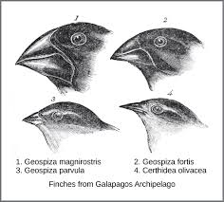
Evolution
Darwin’s Theory
Galapagos Islands off of South America
Studied finches who came from S.A. to the islands and changed a little over time in a process called evolution
Shared a common ancestor and look at chemicals in cells (DNA)
Ex: skunks and weasels

Slide 13
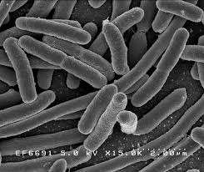
Domains
Domain Bacteria:
Unicellular
Prokaryotes: lack nuclei
May be autotrophs or heterotrophs
Helpful or harmful

Slide 14
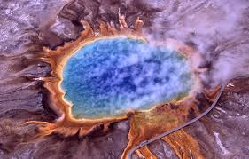
Domains
Domain Achaea:
Found in some of the most extreme environments like hot springs or vents in ocean floors
Unicellular prokaryotes
Can be autotrophs or heterotrophs
Differences in structure and chemical make up

Slide 15
Domain Eukarya
Eukaryotes: organisms where cells contain nuclei
4 Kingdoms:
Protists
Don’t fit in other categories
Most unicellular
Auto- or heterotrophs
Fungi
Molds, mushrooms, and mildew
Heterotrophs and feed by absorbing nutrients from dead or decaying organisms
Found almost everywhere on land
Plants
Multicellular
Most live on land
autotrophs
Animals
Multicellular
Heterotrophs
Different adaptations that allow them to locate food, capture it, eat it, and digest it

Slide 16
Origin of Life
Ancient Atmosphere
Nitrogen, water vapor, carbon dioxide, and methane
Ancient Landscape
Rugged rock
No green
Lightning flashes, thunder, howling winds, and waves pounding shore
Current atmosphere
Oxygen and nitrogen

Slide 17
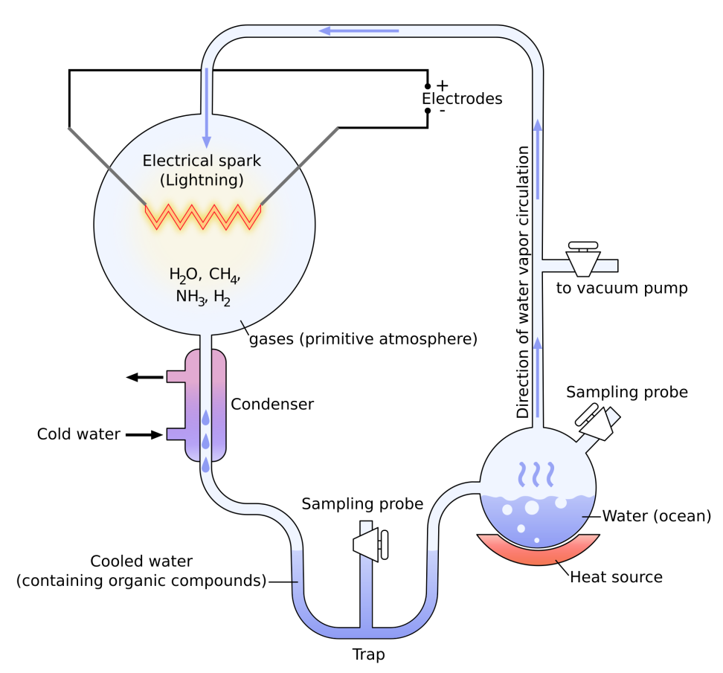
Origin of Life
Life appeared between 3.5- 4 billion years
No oxygen
Unicellular
Lived in ocean
Resembled Archaea
Heterotrophs that used chemicals in their surroundings
Miller and Urey
Recreated conditions of early Earth
Water and mixture of gases
No oxygen or unicellular organisms
Electric current
Weeks later dark fluid with small chemical units that could form proteins

Slide 18
Fossil Evidence
Achaea-like organisms from between 3.4 to 3.5 billion years ago
First cells used up chemicals available
Some cells develop ability to make their own food so they produced oxygen.
Levels of oxygen increased in atmosphere.
There are still many unanswered questions about the origin of life.

