Slide 1
Protists and Fungi

Slide 2
What is a Protist?
Eukaryotes that cannot be classified as animals, plants, or fungi
Live in moist environments
Most unicellular, but a few are multicellular
Can be heterotrophic, autotrophic, or both
Some can move, but other can’t.
3 categories

Slide 3
Animal-like Protists
Heterotrophic
Able to move from place to place to obtain food
Unicellular
Called protozoans
4 groups based on the way they move and live

Slide 4
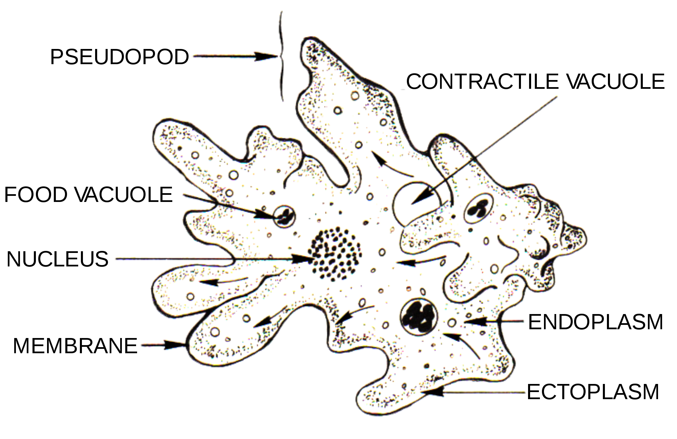
Protozoans with pseudopods
Amoeba belongs to a group called sarcodines
Pseudopods allow it to move and feed
False foot
Cytoplasm flows toward one location and rest of organism follows
Traps food
Contractile vacuole-collects extra water and then expels it

Slide 5
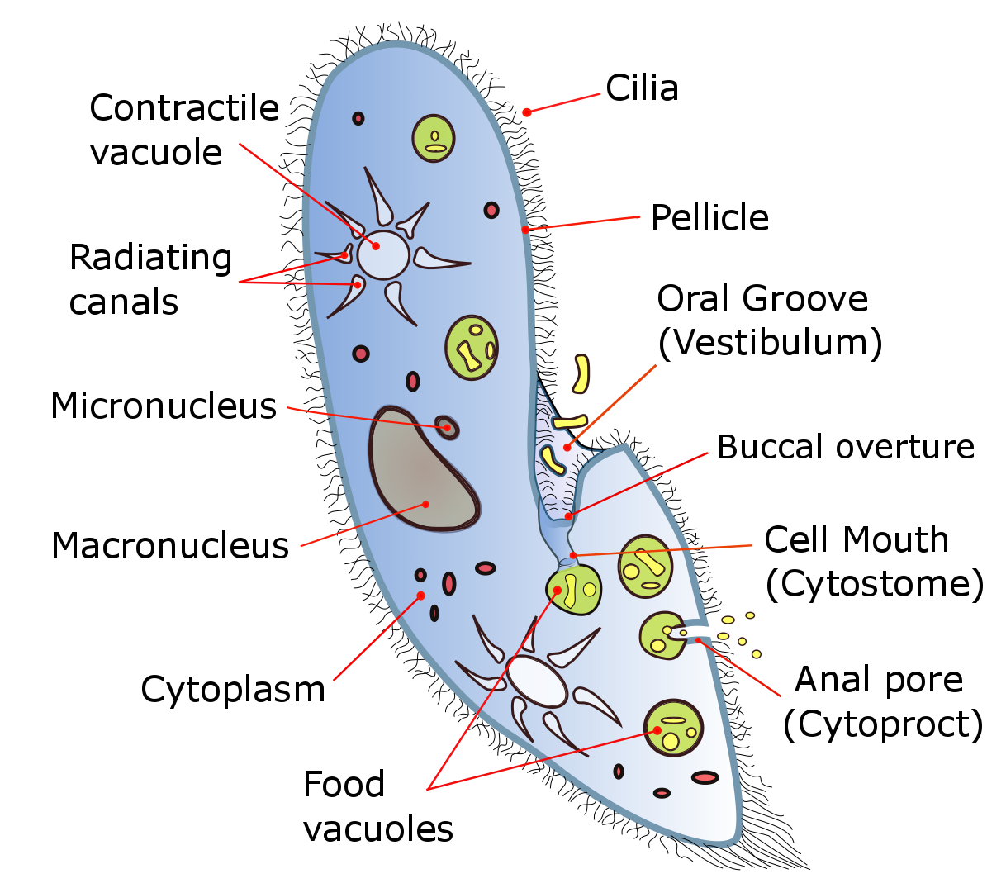
Protozoans with Cilia
Paramecium in group called ciliates
Cilia-hairlike projections from cells that move with a wavelike motion
Move and obtain food
Tiny oars that sweep food into organism
Two contractile vacuole
More than one nucleus
Large-controls everyday tasks
Small-reproduction
Reproduce asexually by binary fission
Reproduce sexually by conjugation

Slide 6
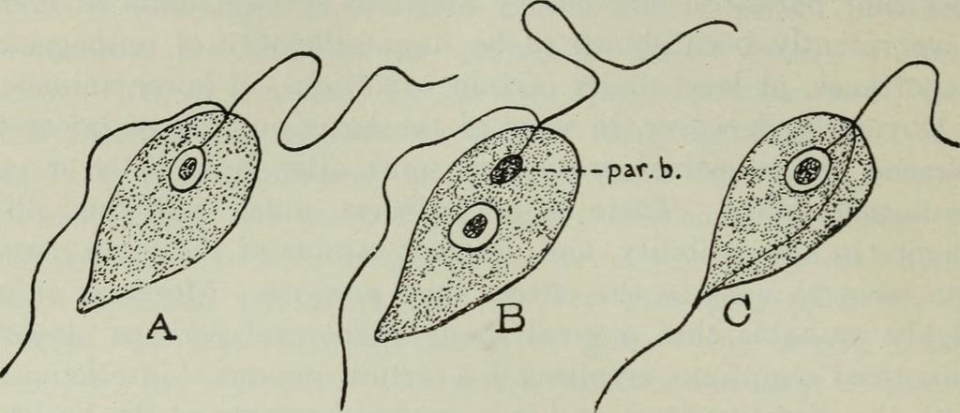
Protozoans with Flagella
Flagellates
Flagella-long whiplike flagella to move
May have one or more
Some live inside other organisms
Intestines of termites
Symbiotic relationship called mutualism
Help digest wood
Giardia in humans
Attach a person’s intestines

Slide 7
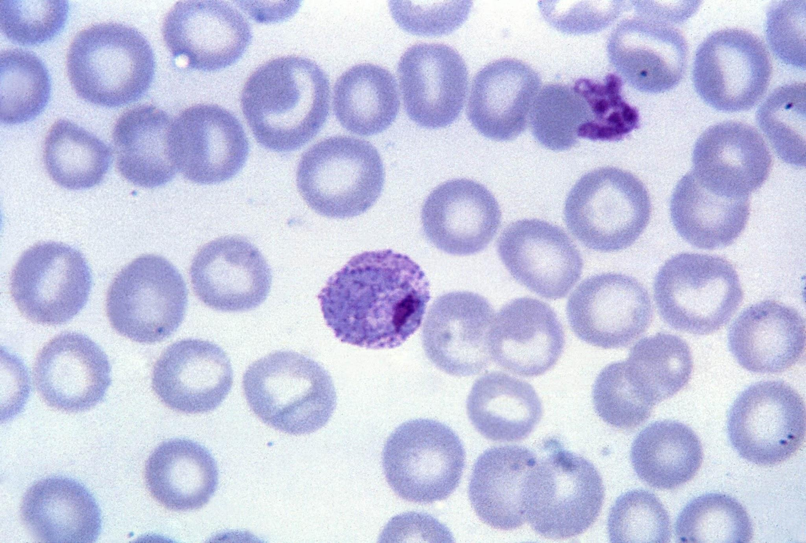
Protozoans That Are Parasites
Feed on the cells and body fluids of their hosts
May have flagella, may depend on hosts for transport, or have slime
Plasmodium
Causes malaria

Slide 8
Plantlike Protists
Commonly called algae
Autotrophs that use the sun’s energy to make food
Role in environments
Important food source for organisms in water
Makes a lot of the oxygen in atmosphere
May be unicellular or multicellular
Variety of colors (pigments)
Green, yellow, red, brown, orange or even black

Slide 9
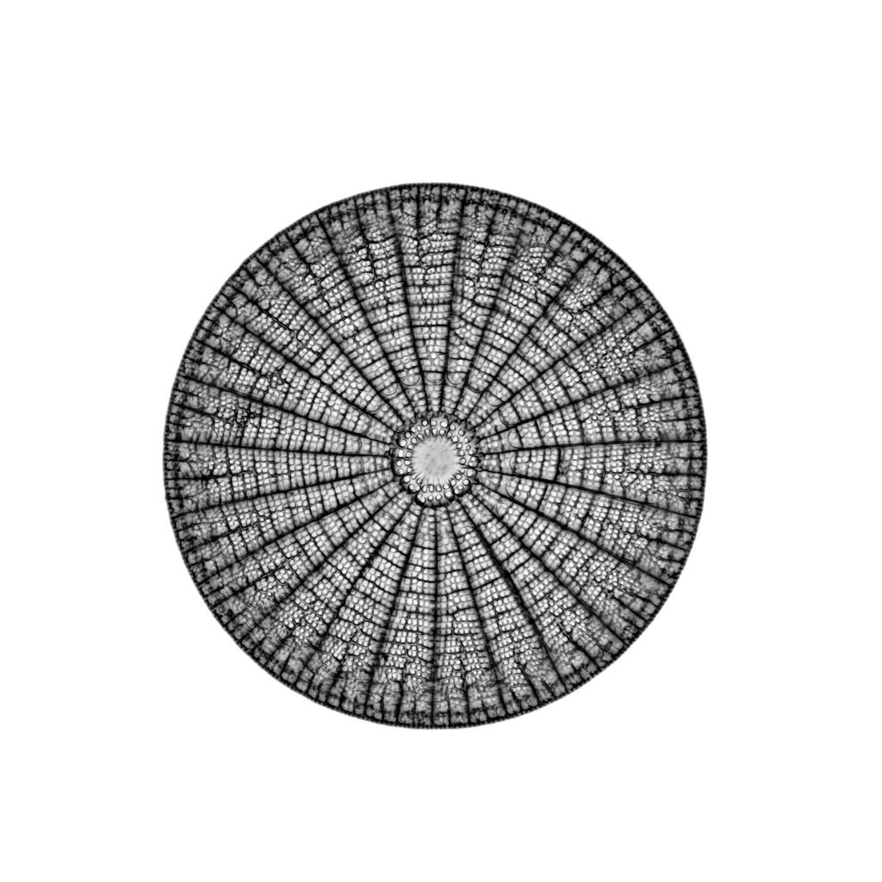
Diatoms
Unicellular protists with beautiful glass-like walls
Float on surface of lakes or oceans
Food source
Move by oozing chemicals out slits in cell walls and then glide
Diatomaceous earth
Forms when diatoms die and collect on bottoms of oceans and lakes
Make good polishing agent
Insecticides

Slide 10
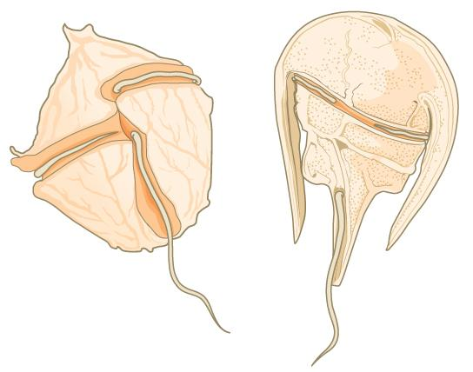
Dinoflagellates
Unicellular algae surrounded by stiff plates that look like suits of armor
Variety of colors
Two flagella held in grooves between plates
Twirl like toy tops
Glow in the dark

Slide 11
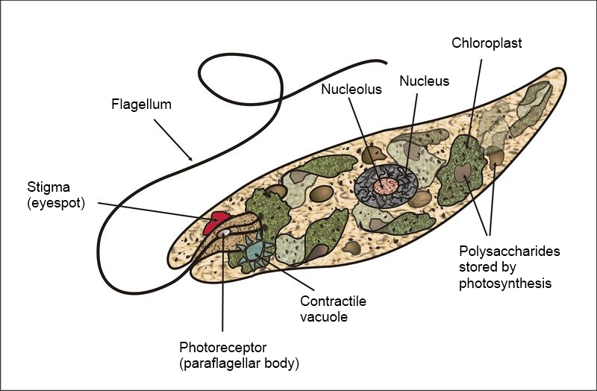
Euglenoids
Green, unicellular
Found in freshwater
Most of the time autotrophs
Can be heterotrophs under certain conditions (when no sunlight)
Long, whiplike flagellum
Eyespot-pigments that are sensitive to light and helps the euglena recognize the direction of light source

Slide 12
Algae
Red Algae
Multicellular seaweed
260 meters below ocean’s surface
Red pigment can absorb small amount available
Carrageenan and agar extracted and used to make ice cream and hair conditioners
Nutrient rich and eaten fresh, dried, or toasted
Green Algae
Unicellular, few multicellular
Live in fresh or salt water
Few live on land on rocks, crevices of tree bark, or in moist soil

Slide 13
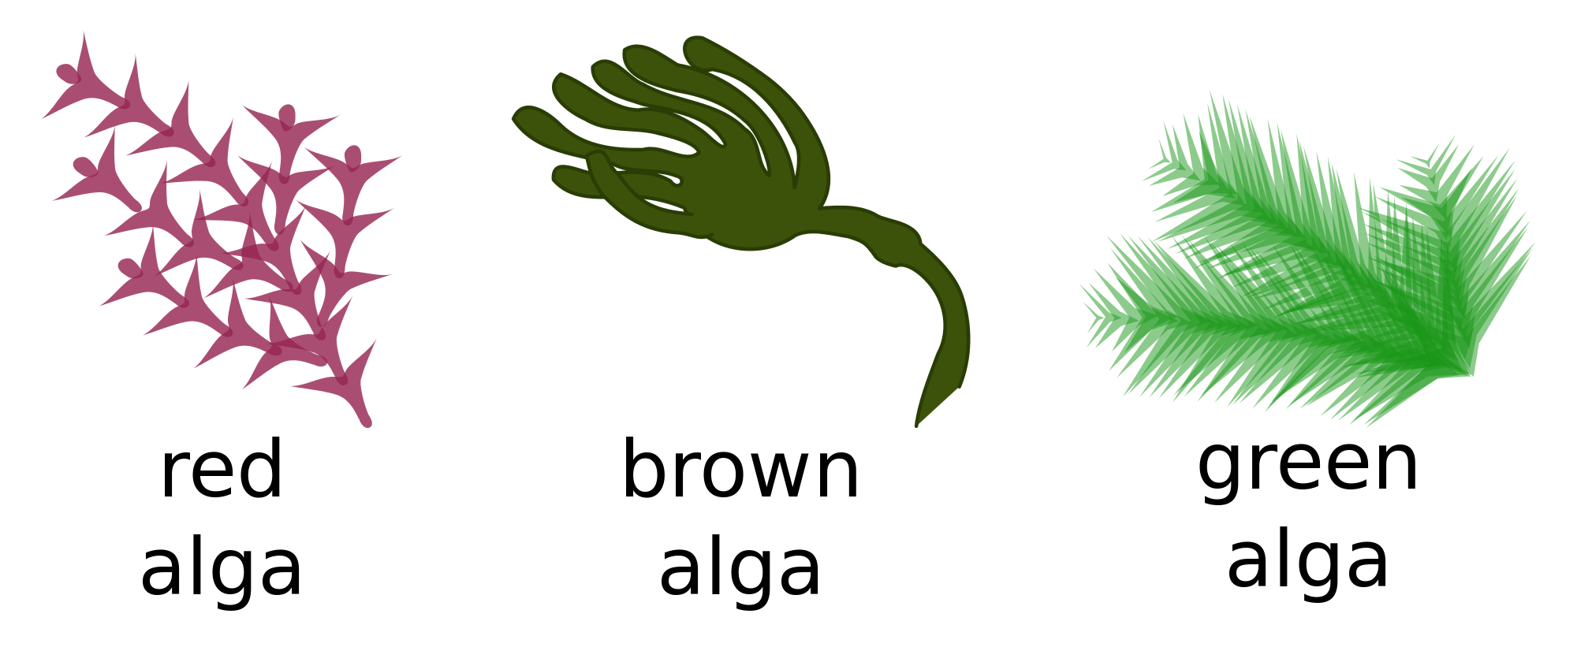
Brown Algae
Contain green, yellow, and orange pigments
Holdfasts-anchor the algae to rocks
Stalks support blades
Gas-filled sacs called bladdars that allow algae to float upright
Cool, rocky waters
Eat brown algae
Algins extracted to use as thickeners in puddings and other foods

Slide 14
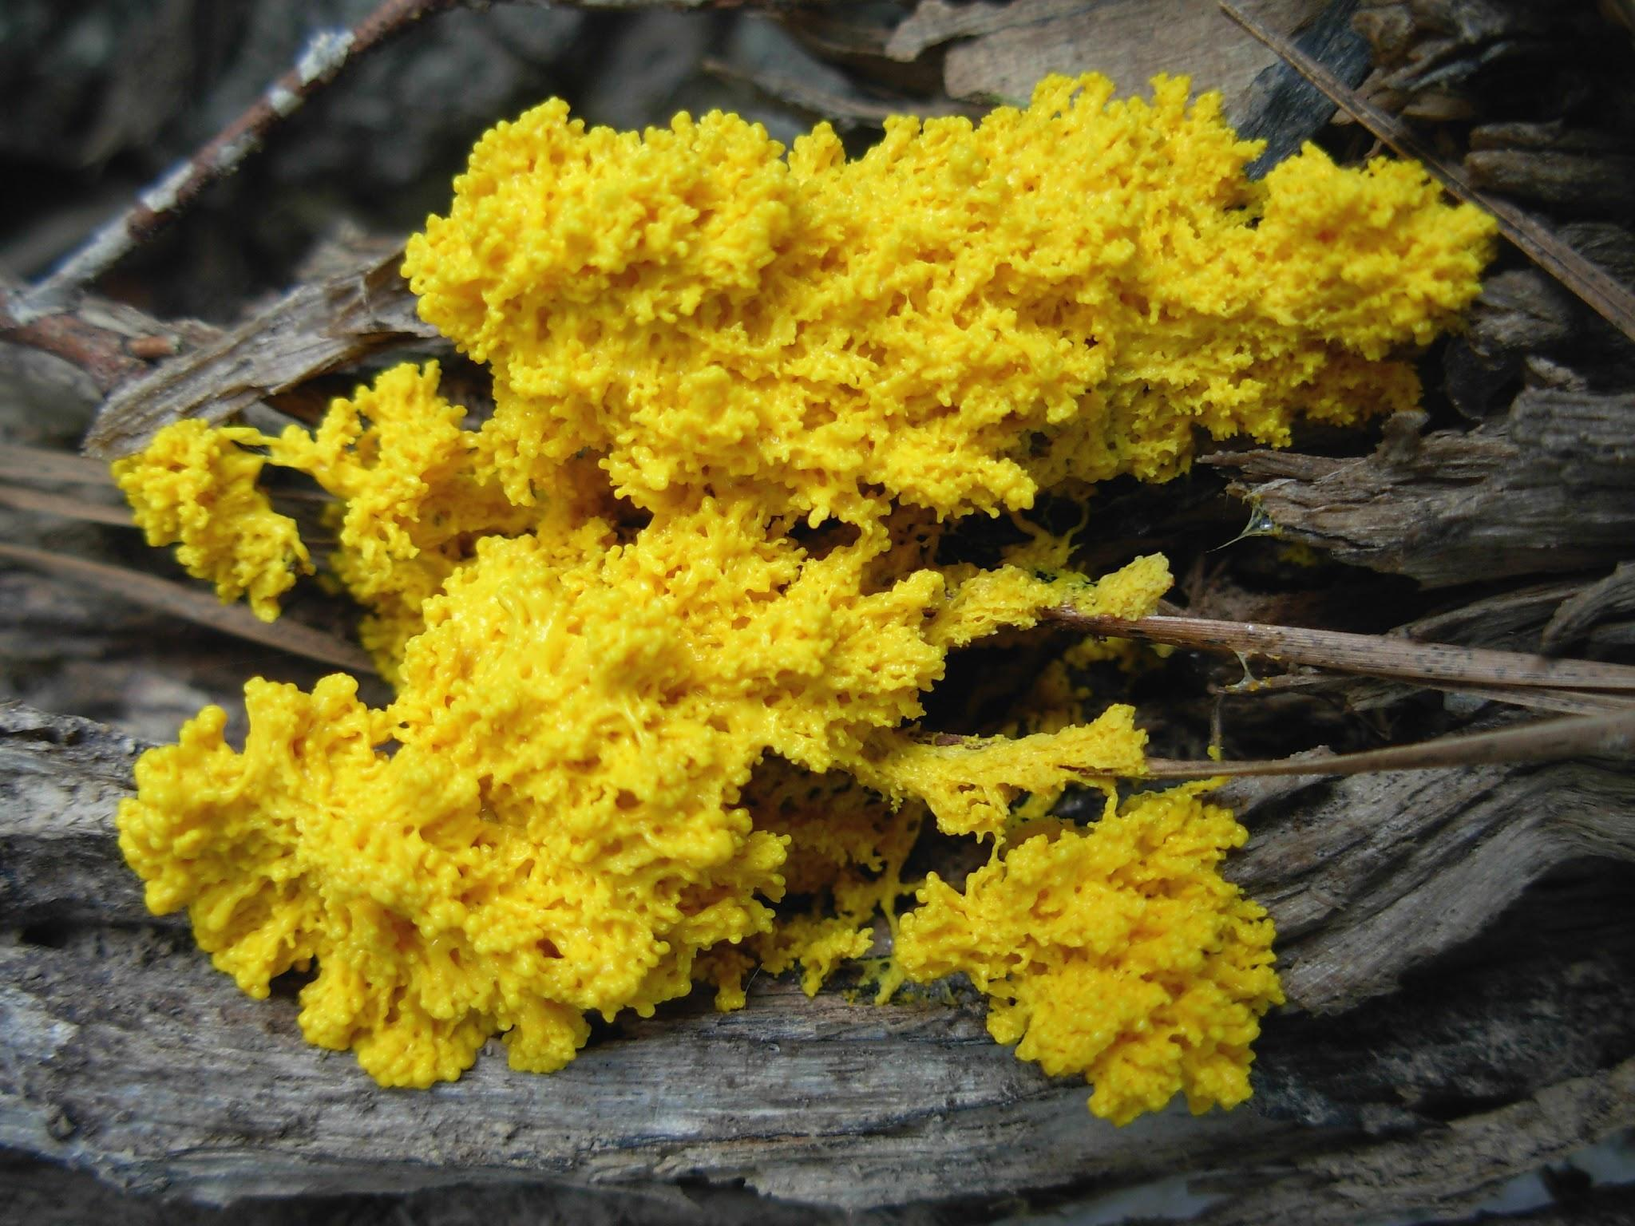
Funguslike Protists
Reproduce using spores
Tiny cell able to grow into a new organism
Heterotrophs
Have cell walls
Able to move at some point in their lives
Slime molds
Brilliantly colored
Live on forest floors and othe moist, shady places
Microscopic
Begin as amoebalike cells
Cells grow bigger or join together to form jellylike mass
Giant cell with many nuclei
Oozes along as a single unit
Harsh conditions produce spores

Slide 15
Funguslike Protists
Water Molds and Downy Mildews
Live in water or moist places
Grow as tiny treads that look like fuzz
Attack many food crops such as potatoes, corn, and grapes
Example: Irish potato famine

Slide 16
Saltwater Blooms
Red tides
Causes
Occur when there is an increase in nutrients in the water
When cold water at bottom that contains nutrients rises and mixes with the surface waters.
Increases in ocean temperatures due to climate change also affects occurence
Effects
Dangerous when toxins that the algae produce become concentrated in bodies of organisms that consume the algae
Shellfish, clams and mussels feed on algae and store toxins

Slide 17
Freshwater Blooms
Eutrophication-process in which nutrients, such as nitrogen and phosphorus, build up in a lake or pond over time
Usually green algae
Causes
Farmers and homeowners use fertilizers and the runoff gets into lakes and ponds
Sewage treatment plants can leak wastewater
Effects
Triggers a series of events
Layer of algae prevents sunlight from reaching plants and algae beneath the surface
Organisms die and sink to the bottom
Decomposers such as bacteria break down organisms and increase in number
Bacteria use up the oxygen in water and other organisms die

Slide 18
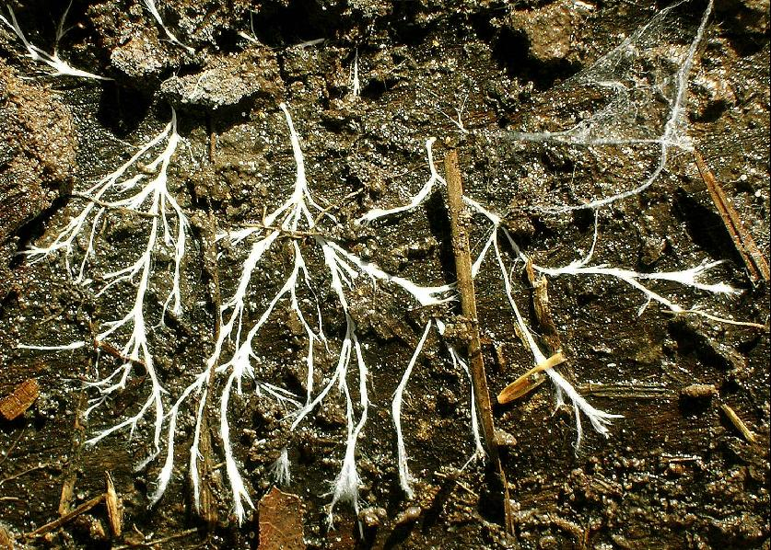
Fungi
Eukaryotes that have cell walls
Heterotrophs that feed by absorbing their food
Use spores to reproduce
Need moist, warm places to grow
Unicellular or multicellular
Mushrooms, molds, and yeasts
Largest grows underground and covers an area as large as a 1000 football fields
Hyphae-branching threadlike tubes that make up the bodies
Cont. threads of cytoplasm with many nuclei
Absorb food by oozing digestive juices into food
Feed on dead organisms or some are parasites

Slide 19
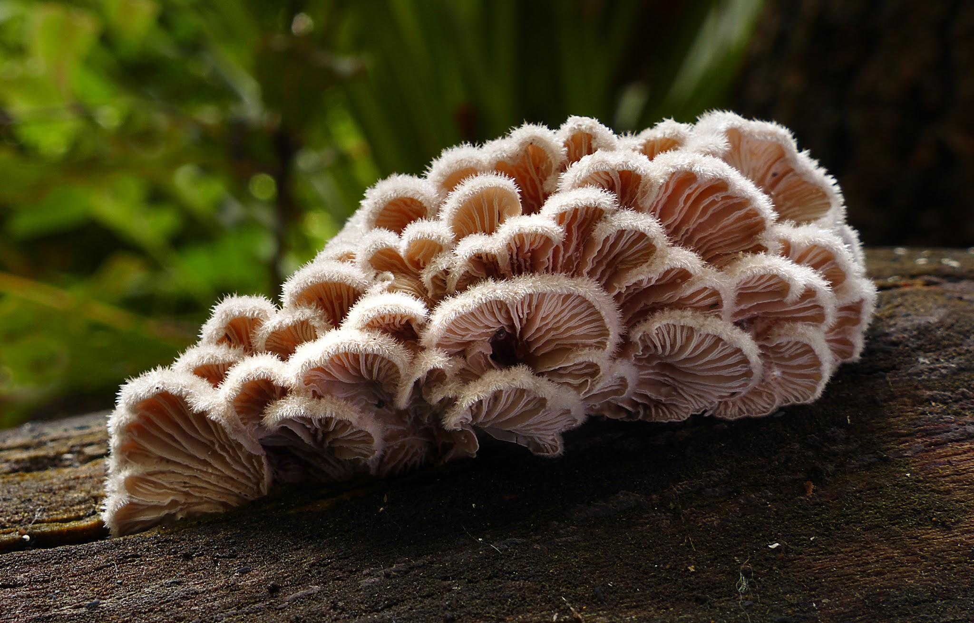
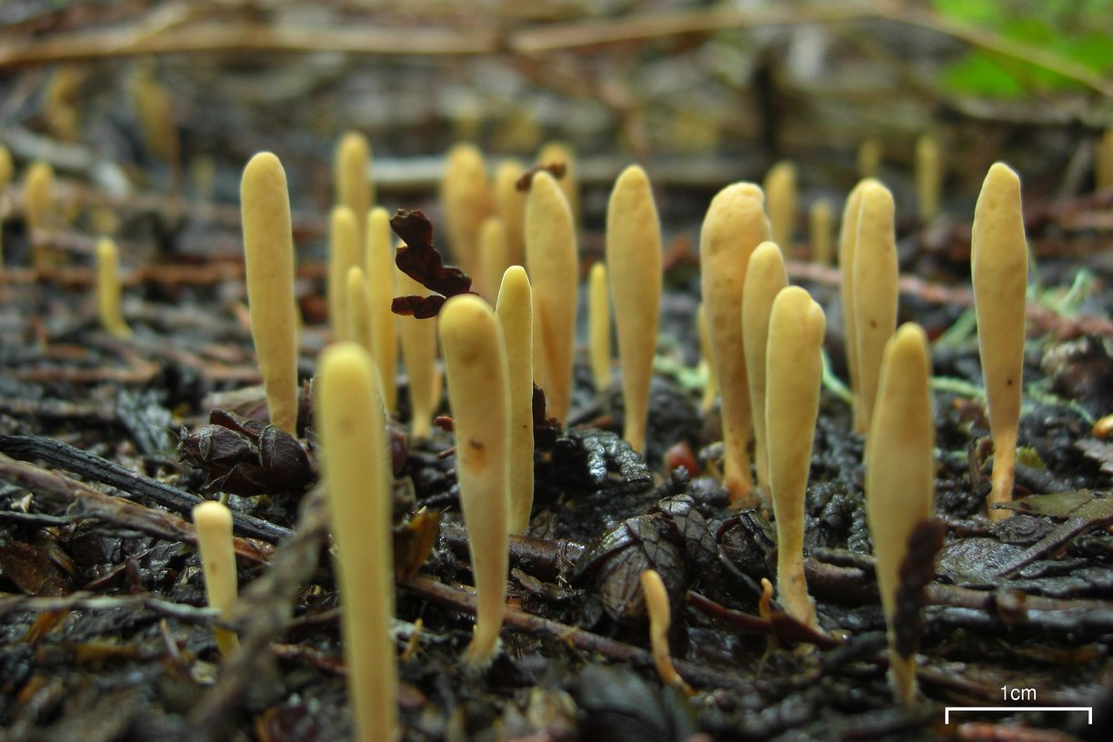
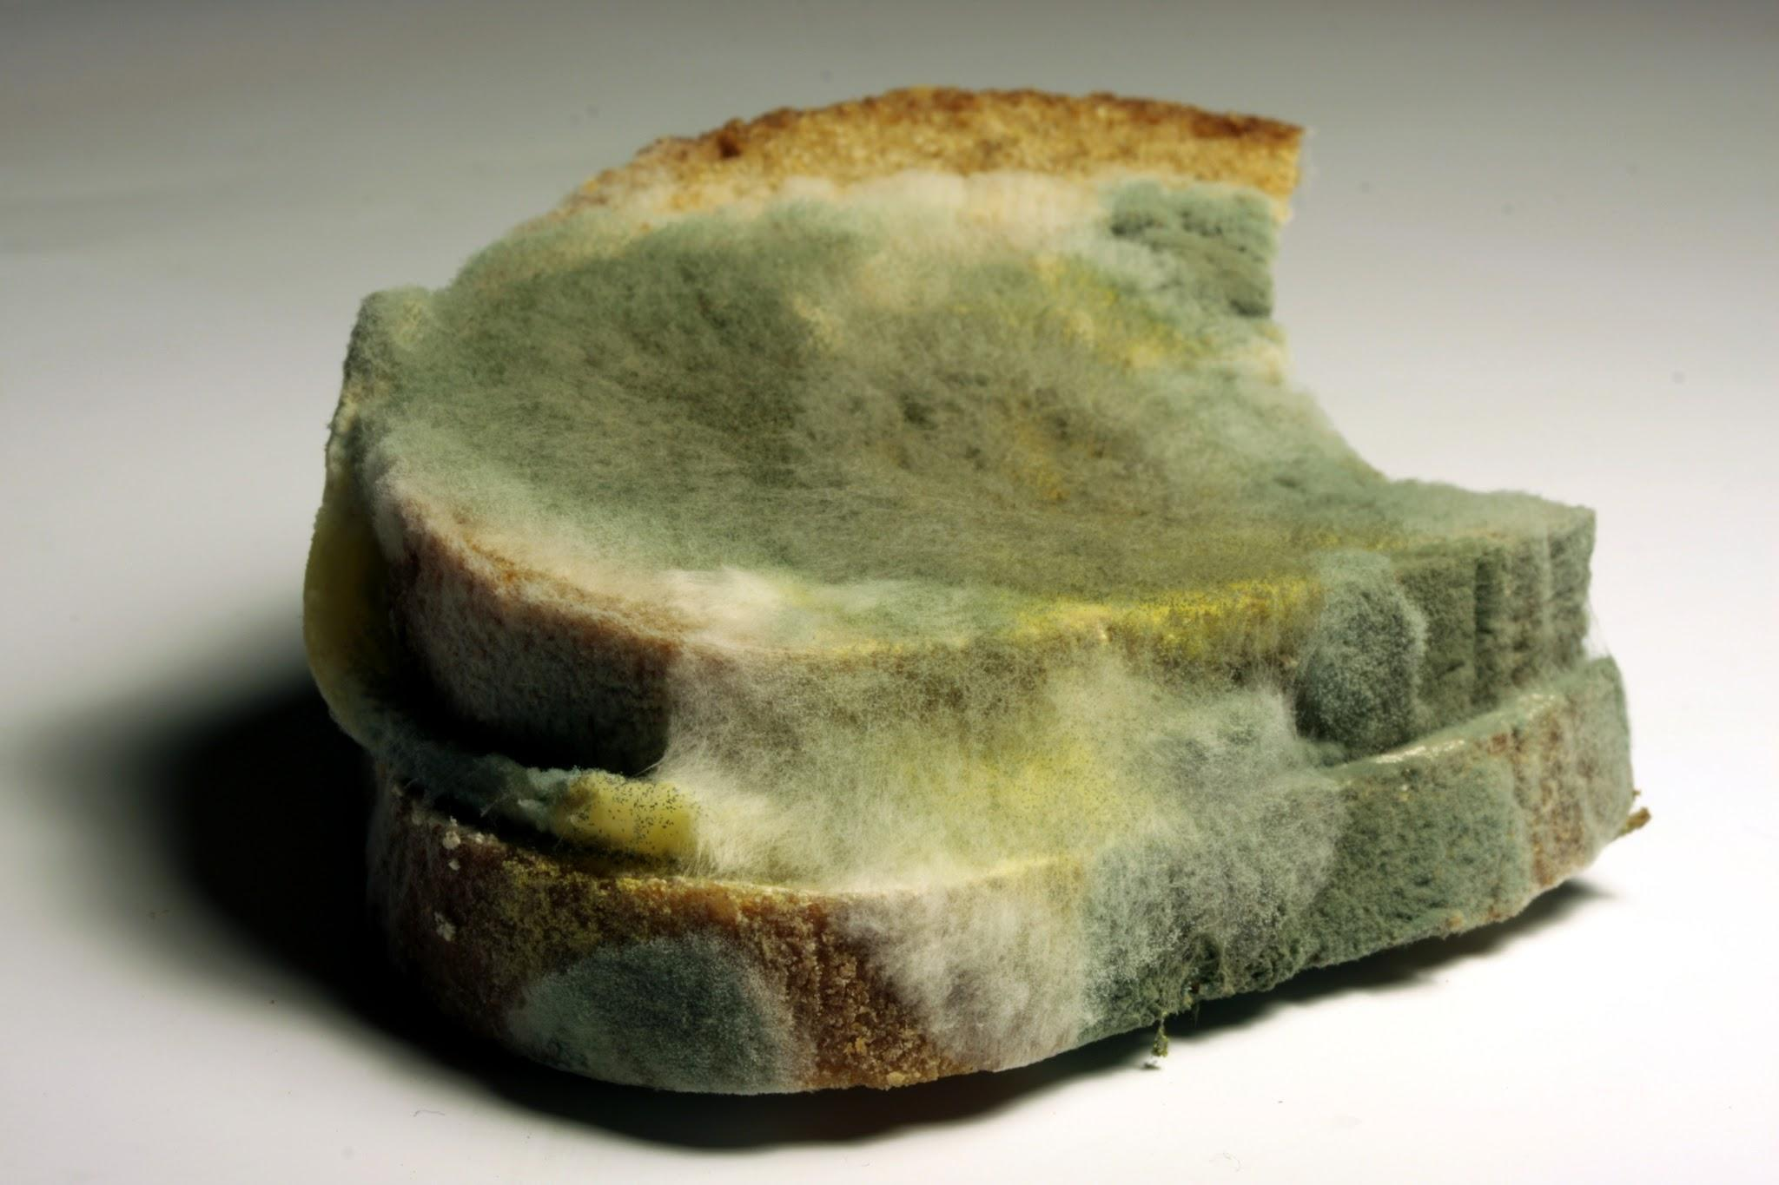
Classification of Fungi
Sac fungi
Produce spores in structures at tips of hyphae
Yeasts, morels, truffles, and some lichens
Club fungi
Produces spores in structures that look like clubs
Mushrooms, bracket fungi, and rusts
Most poisonous fungi
Zygote fungi
Produce very resistant spores that can survive harsh conditions
Common fruit and bread molds
Attack and kill insects

Slide 20
Reproduction
Usually make spores
Surrounded by protective covering and can be carried easily through air or water to new sites
Produced in fruiting bodies
Asexual reproduction
When there is adequate moisture and food most produce spores
Unicellular yeasts undergo budding where a new cell grows from body of parent
Sexual reproduction
When conditions become unfavorable
Hyphae of two fungi grown together and genetic material is exchanged
New structure grows from joined hyphae and produces spores

Slide 21
Role in Nature
Environmental recycling
Food and fungi
Baker’s yeast
Molds used in the production of foods like blue cheese.
Disease-fighting fungi
Mold named Penicillium kills bacteria and used to make antibiotics. (discovered by Flemming)
Disease-causing fungi
Dutch elm disease, corn smut, wheat rust, athlete’s foot

Slide 22
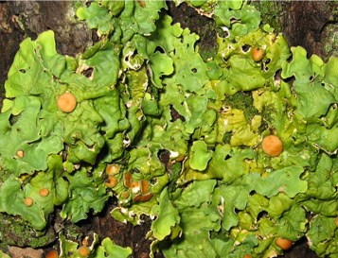
Role in Nature
Fungus-Plant Root Associations
Hyphae spread out underground and absorb water and nutrients from soil for plants
Fungus gets to feed on the extra food that they plant makes and stores
Lichens
Consists of a fungus and either an algae or autotrophic bacteria in a mutualistic behavior
Irregular, flat, crusty patches that grown on tree barks or rocks
Fungus benefits from the food produced.
Algae or bacteria obtain shelter, water, and minerals from fungus
Often pioneer organisms
Break down rock into soil
Sensitive to pollution

