Slide 1
Viruses and Bacteria

Slide 2
Virus
Tiny, nonliving particle that enters and then reproduces inside a living cell
Characteristics
Not cells
Do not use their own energy to grow or to respond to their surroundings
Cannot make their own food, take in food, or produce wastes
Multiply only inside a living cell (host
Acts like a parasite and destroy living cell

Slide 3
Virus
Shapes: rod-shaped, round, bricks, threads, or bullets
Bacteriophage: virus that infects bacteria
Sizes
20-200 nanometers
Naming
No binomial nomenclature
Named after disease they cause
Named after organism they infect
Named for people who first identify them

Slide 4
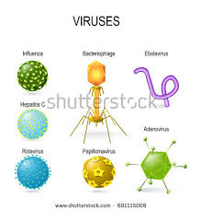
Virus
Protein coat that protects
Proteins on the outside allow virus to attach certain cells in host (lock and key)
Inner core made of genetic material

Slide 5
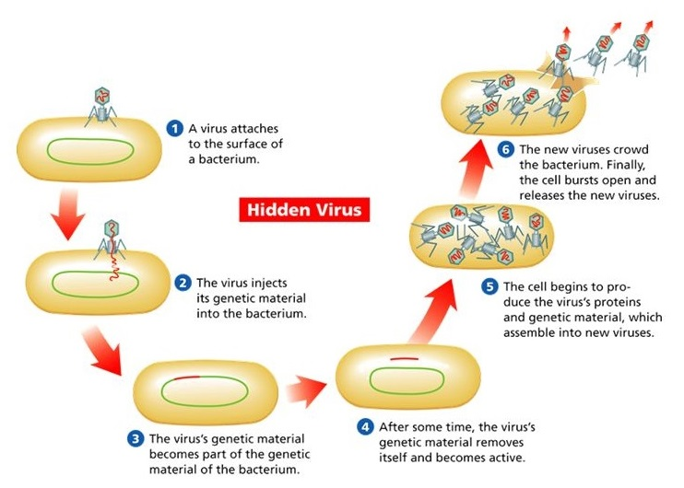
How Viruses Multiple

Slide 6
Virus
Active Virus
Immediately goes into action
Takes over cells function
Hidden virus
Genetic material becomes part of cell’s genetic material
Does not appear to affect the cells functions and may stay in this inactive state for years
Under certain conditions it will become active
Ex: cold sores
Stress or sunlight may activate

Slide 7
Viruses and the Living World
People: colds and AIDS
Apple trees-apple mosiac virus and produces less fruit
Pets: rabies and distemper
Gene therapy
Future medical treatment for cystic fibrosis
Add or insert DNA into cells that need it

Slide 8
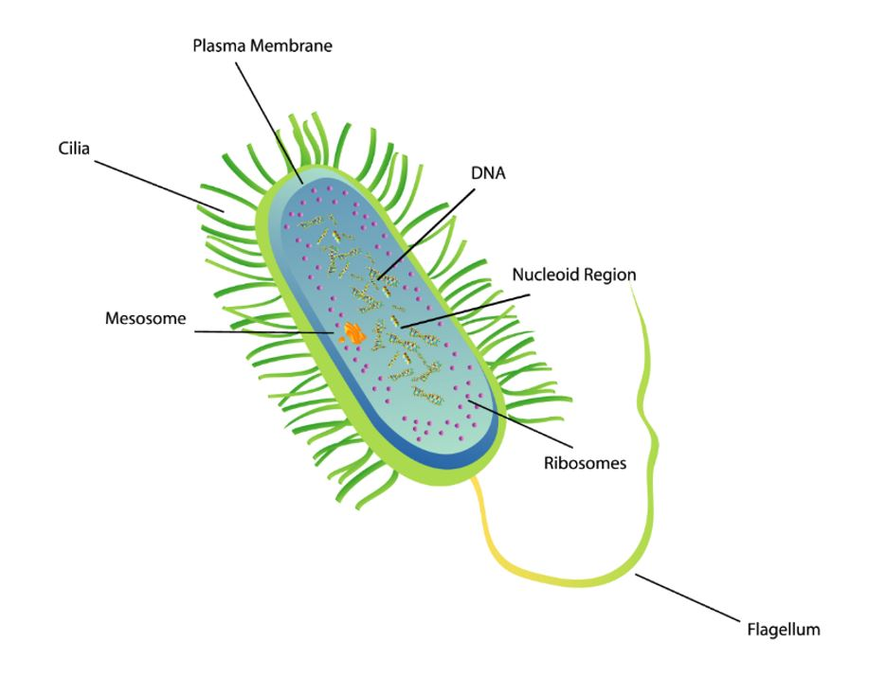
Bacteria
Unicellular
Prokaryotic
No nucleus
Rigid cell wall
Cytoplasm
Ribosomes-make proteins
Genetic material in cytoplasm
Flagellum-
Movement
Many, one or none

Slide 9
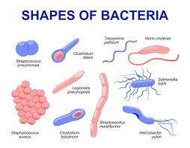
Bacteria
Shapes
Spherical, rod-like, or spiral
Sizes
0.5 to 1 micrometer

Slide 10
How Bacteria Obtain Energy
Autotrophic and make their own energy
From sun
From chemicals in their environment
Heterotrophic or can’t make their own food
Consume other organisms like milk, meat, or decaying leaves
Respiration-breaking down foods to produce energy
Most need oxygen, but a few do not need oxygen

Slide 11
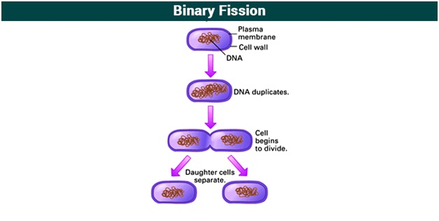
Reproduction
Asexual reproduction
Process of only having one parent to produce offspring that is identical
Binary fission-one cells divides into two identical cells

Slide 12
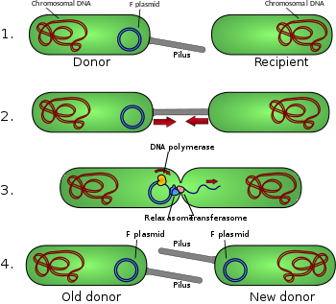
Reproduction
Sexual reproduction
Process that involves two parents who combine their genetic material to produce a new organism that is different from parent
Conjugation: bacterial transfers some of its genetic material into another bacterium through a thin, threadlike bridge

Slide 13
Endospore Production
Form when conditions in environment become unfavorable for growth
Food sources disappear
Water can dry up
Temperature rises or falls
Endospore
Small, rounded, thick-walled resting cell that forms inside a bacterial cell
Contains genetic material and some cytoplasm
Can resist freezing, heating, and drying
Can survive for many years
Ex: botulism can survive if foods are not canned properly

Slide 14
Role of Bacteria in Nature
Oxygen production
Autotrophic bacteria release oxygen
Food production
Produce cheese, sauerkraut, pickles, apple cider, buttermilk, yogurt, sour cream, and cheeses
Heating (pasteurization) and cooling kill bacteria
Environmental recycling
Decomposers break down dead organisms
Nitrogen fixing bacteria
Environmental cleanup (oil spills)
Health and medicine
Live in digestive system and make vitamins
Manufacture bacteria to make insulin

